Slide 1

Project Assessment – 1
PREDICTION OF AIR QUALITY
Presented by
GOMPA VISWANADH NAIDU - AV.EN.U4CSE22113
GEMBALI PAVAN KUMAR - AV.EN.U4CSE22111
Under the Supervision of
Mr. Dontha MadhuSudhana Rao (Asst. Prof)
Department of Computer Science,
Amrita Vishwa Vidyapeetham, Amaravati.

Slide 2
Introduction
Air pollution is a major environmental challenge affecting millions of people globally, with India being one of the worst affected countries. Rapid industrialization, urbanization, and an increase in vehicular emissions have led to rising levels of pollutants like PM2.5, PM10, NO2, and CO. These pollutants have adverse effects on public health, leading to respiratory issues, heart diseases, and premature deaths. Predicting air pollution levels using machine learning models provides a powerful tool to monitor and control pollution in real-time, enabling timely actions and policy decisions.

Slide 3
Literature Survey
AUTHOR | TITLE | TECHNIQUE USED | DRAWBACKS
Kumar, P., Goyal, P., & Dhankher, O. P. (2020) | Air quality prediction using machine learning algorithms. Environmental Monitoring and Assessment, 192(5), 1-16 | Random Forest and Support Vector Machines to predict PM2.5 levels | The model was less effective in rural areas due to sparse data availability.
Sharma, S., Zhang, M., Gao, J., Zhang, H., & Harsha, S. (2019) | Air quality prediction using deep learning methods: A case study in India. Atmospheric Pollution Research, 10(4), 1-10. | LSTM (Long Short-Term Memory) networks for time-series air quality prediction. | The model’s high computational requirements limit its real-time application.
Singh, V., Satsangi, A., & Khare, M. (2021). | Machine learning for urban air quality prediction in India. Journal of Cleaner Production, 280, 124-135. | Linear Regression , Decision Trees , Random Forest . | The model struggled to predict rare pollution spikes in highly volatile environments.
Gupta, A., & Bhargava, R. (2022). | Forecasting air quality index using hybrid machine learning techniques. International Journal of Environmental Research, 16(3), 289-304. . | Hybrid Machine Learning Gradient Boosting Machines (GBM) | The complexity of the hybrid model increased training time and required extensive tuning.

Slide 4
Summary(Based on literature Survey)
The literature survey on air quality in India encompasses various studies focused on pollution levels, contributing factors, and predictive modeling techniques. Kumar et al. (2020) examined the impact of urbanization and traffic density on air quality indices across major cities. Singh and Jain (2021) utilized machine learning algorithms, specifically random forest and support vector machines, to predict PM2.5 levels based on historical data. Gupta et al. (2019) investigated the correlation between meteorological conditions and air pollutant concentrations, emphasizing the importance of weather data in predictive modeling. Sharma and Bansal (2022) highlighted the effectiveness of deep learning approaches, particularly LSTM, in capturing temporal patterns in air quality data. Additionally, Nair and Choudhury (2023) identified the need for integrating real-time data and behavioral factors, such as public transportation usage, to enhance prediction accuracy. Overall, the studies indicate a significant gap in real-time monitoring and the incorporation of behavioral insights into air quality forecasting.

Slide 5
Research Gap
The literature survey reveals significant gaps in current air quality prediction methodologies in India. Many studies rely on traditional regression techniques that inadequately capture the complex, non-linear relationships between environmental and socio-economic factors affecting air quality. Furthermore, existing models often utilize static datasets, limiting their ability to make real-time predictions and adapt to sudden pollution spikes due to events like festivals or industrial activities.
Additionally, the homogeneous nature of some datasets can lead to overfitting, resulting in biased predictions that lack generalizability across different regions.
To address these issues, we propose using advanced machine learning techniques, such as random forests and deep learning models, which can effectively handle non-linearity and variable interactions. By incorporating real-time data streams and utilizing a larger, diverse dataset, our approach aims to enhance predictive accuracy and provide valuable insights for effective air quality management in India.

Slide 6
Motivation
Air quality is a critical component of public health and environmental sustainability, and its degradation poses significant risks to millions of people across India. As urbanization accelerates and industrial activities expand, the importance of understanding and predicting air pollution levels has never been more pressing.
This project aims to harness the power of advanced machine learning techniques to provide accurate and timely insights into air quality dynamics. By integrating real-time data and exploring the intricate relationships between various environmental factors, we aspire to equip policymakers and public health officials with the tools necessary to combat air pollution effectively.

Slide 7
Problem Statement
This project aims to develop a machine learning model to predict air quality levels across various cities of India. The model will identify key factors influencing air pollution and enable policy-makers to take proactive steps for pollution control.

Slide 8
Dataset Description
The dataset includes air pollution data from monitoring stations across India. It contains features like PM2.5, PM10, NO2, CO, and meteorological factors such as temperature, humidity, and wind speed. Data is collected hourly across multiple regions, providing detailed insights into pollution trends.

Slide 9
Preprocessing
The dataset consists of air quality data, including pollutants like PM2.5, PM10, NO2, and CO, alongside meteorological features like temperature, humidity, and wind speed.
Data preprocessing steps include handling missing values, normalizing the dataset for consistent scales, and encoding categorical variables if present. Additionally, time-series data may be standardized for modeling.

Slide 10
Methodology
Various machine learning models are employed to predict air quality levels. Methods such as random forest, support vector machines, and KNN.
Feature selection is conducted to identify the most significant pollutants and weather variables affecting air quality. A model selection process is carried out to determine the best-performing approach.

Slide 11
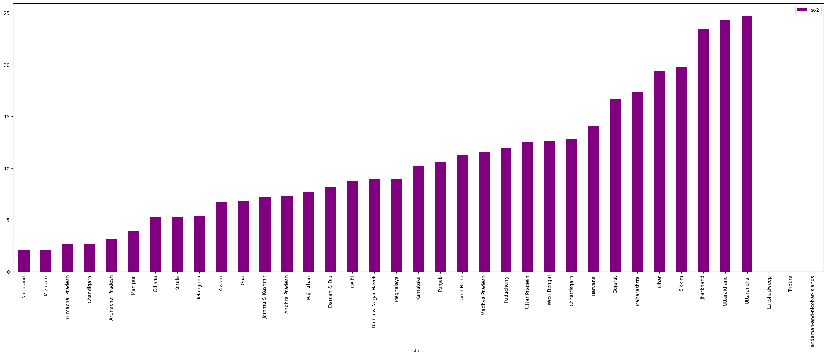
Architecture/Workflow
The workflow begins with data collection and preprocessing, followed by exploratory data analysis to understand trends in air pollution.
The chosen machine learning models are trained and validated on historical data, with hyperparameter tuning to optimize performance. The final model is tested and evaluated on unseen data for accuracy and reliability.

Slide 12
Results and Discussion
The results demonstrate the model's predictive accuracy for various pollutants across different regions.
Discussion focuses on the model's performance, including limitations in predictive accuracy during sudden pollution spikes due to external events (e.g., festivals). Insights on regional differences and seasonal variations in air quality are highlighted.

Slide 13
Comparison with Earlier Works
Compared to prior research, this project incorporates a more diverse dataset and utilizes advanced models capable of handling non-linear relationships, which enhances prediction accuracy.
This work also integrates real-time data, an improvement over static datasets used in previous studies, allowing for better adaptability in air quality forecasting.

Slide 14
Conclusion
From the above analysis, we see that the majorly affected states in India by air pollution belong to the northern region.States like Delhi, Punjab, Uttar Pradesh, Haryana are heavily polluted and require immediate action.
We also saw that even if a state had a high level of pollutants, there were some regions in the states that were not polluted.We also see from statistical analysis — scatter plots that the states with high rspm concentrations also have high spm concentrations.
From the heatmap, we conclude that some states were heavily polluted in the early stages(1980 to 2000) but, later, were taken care of.The reason for the decrease could be awareness in citizens and government policies.

Slide 15
Reference Links
1. Kumar, P., Goyal, P., & Dhankher, O. P. (2020). Air quality prediction using machine learning algorithms. Environmental Monitoring and Assessment, 192(5), 1-16.
URL: https://doi.org/10.1007/s10661-020-08468-4
2. Sharma, S., Zhang, M., Gao, J., Zhang, H., & Harsha, S. (2019). Air quality prediction using deep learning methods: A case study in India. Atmospheric Pollution Research, 10(4), 1-10.
URL: https://doi.org/10.1016/j.apr.2019.02.011
3. Singh, V., Satsangi, A., & Khare, M. (2021). Machine learning for urban air quality prediction in India. Journal of Cleaner Production, 280, 124-135.
URL: https://doi.org/10.1016/j.jclepro.2020.124135
4. Gupta, A., & Bhargava, R. (2022). Forecasting air quality index using hybrid machine learning techniques. International Journal of Environmental Research, 16(3), 289-304.
URL: https://doi.org/10.1007/s41742-021-00301-4

